Slide 1
Lecture 24
Hardware Solutions
National University of
Computer & Emerging Sciences

Slide 2
CS Problem – S/W based solutions
Bakery and Peterson Solutions solve the critical section problem – in software
In order to implement an efficient lock why shouldn’t we use algorithms such as Peterson or Bakery?

Slide 3
Why does it fail then?
Not because of our logic, but because of wrong
assumptions about the real world.
Mutual exclusion depends on the order of steps in the software based algorithms.
However, modern Compilers often reorder instructions to enhance performance

Slide 4
Hardware Approach- CS problem
Disabling Interrupts
Test Set and Lock
Compare and swap

Slide 5
Disabling Interrupts
Solution: A Process
  Disable interrupts before it enters its critical section
  Enable interrupts after it leaves its critical section
CPU will be unable to switch a process while it is in its critical section
Guarantees that the process can use the shared variable without another process accessing it
Disadvantage:
  Unwise to give user processes this much power
  The computer will not be able to service useful interrupts
  The process may never enable interrupts, thus (effectively) crashing the system
However, the kernel itself can disable the interrupts

Slide 6
On a uniprocessor
On a uniprocessor, the only thing that will make multiple instruction sequences not atomic is interrupts.
So, if want to do a critical section, turn off interrupts before the critical section and turn on interrupts after the critical section.
Guaranteed atomicity. It is also fairly efficient.
Early versions of Unix did this.

Slide 7
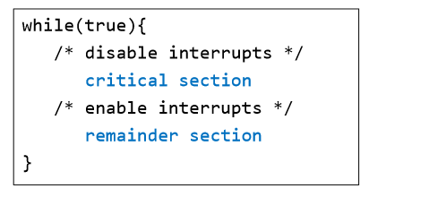
Mutual Exclusion: Hardware Support
– A process runs until it invokes an operating-system service or until it is interrupted
– Disabling interrupts guarantees mutual exclusion

Slide 8
Why not just use turning off interrupts?
main disadvantages:
  can't use in a multiprocessor, and
  Unwise to give user processes this much power
  The computer will not be able to service useful interrupts
  The process may never enable interrupts, thus (effectively) crashing the system

Slide 9
Software Lock
FLAG = TRUE
FLAG = FALSE
FLAG = TRUE
FLAG = FALSE
FLAG = FALSE
The solution will work, if Testing and Setting the Flag are atomic
Process 1
1.while (FLAG == FALSE);
2.FLAG = FALSE;
Process 2
1.while (FLAG == FALSE);
1.while (FLAG == FALSE);
2.
2.FLAG = FALSE;
3.critical_section();
3.critical_section();
4.FLAG = TRUE;
5.noncritical_section();
Timeout
No two processes may be simultaneously inside their critical sections

Slide 10
Hardware Lock
Some instruction sets assist us in implementing mutual exclusion on multiple processors
boolean TestAndSet (boolean *target)
{
boolean rv = *target;
*target = TRUE;
return rv:
}
Guaranteed to be Atomic

Slide 11
TSL is “Atomic”
Atomic => Uninterruptible
No other process can access the memory until TSL is complete
The CPU executing the TSL instruction locks the memory bus
Thus, prohibits others CPUs from accessing the memory
It’s been used for things such as locking mailbox files.

Slide 12
TSL (test-and-set LOCK)
  is an instruction used to write 1 (set) to a memory location
  return its old value as a single atomic (i.e., non-interruptible) operation.
The calling process obtains the lock
if the old value was 0,
otherwise the while-loop spins waiting to acquire the lock.

Slide 13
Mutual Exclusion Using TSL
Shared boolean variable lock., initialized to false.
Solution:
do {
while ( TestAndSet (&lock ))
; // do nothing
// critical section
lock = FALSE;
// remainder section
} while (TRUE);
Notes:
In computer science, the test-and-set instruction is an instruction used to write 1 (set) to a memory location and return its old value as a single atomic (i.e., non-interruptible) operation. ...
The calling process obtains the lock if the old value was 0, otherwise the while-loop spins waiting to acquire the lock.

Slide 14
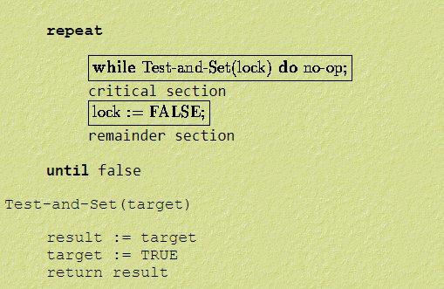
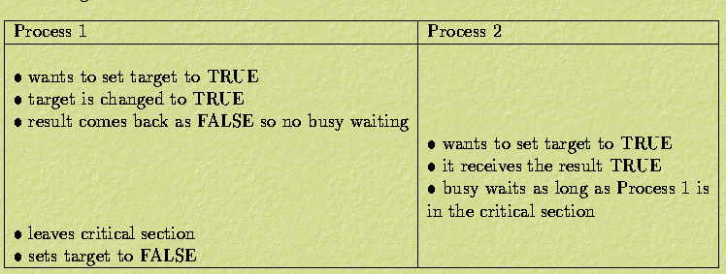

Slide 15
TSL DRY-RUN
Scene-01:
Process P₀ arrives.
It executes the test-and-set(Lock) instruction.
Since lock value is set to 0, so it returns value 0 to the while loop and sets the lock value to 1.
The returned value 0 breaks the while loop condition.
Process P₀ enters the critical section and executes.
Now, even if process P₀ gets preempted in the middle, no other process can enter the critical section.
Any other process can enter only after process P₀ completes and sets the lock value to 0.

Slide 16
TSL DRY-RUN
Scene-02:
Another process P₁ arrives.
It executes the test-and-set(Lock) instruction.
Since lock value is now 1, so it returns value 1 to the while loop and sets the lock value to 1.
The returned value 1 does not break the while loop condition.
The process P₁ is trapped inside an infinite while loop.
The while loop keeps the process P₁ busy until the lock value becomes 0 and its condition breaks.

Slide 17
TSL DRY-RUN
Scene-03:
Process P₀ comes out of the critical section and sets the lock value to 0.
The while loop condition breaks.
Now, process P₁ waiting for the critical section enters the critical section.
Now, even if process P₁ gets preempted in the middle, no other process can enter the critical section.
Any other process can enter only after process P₁ completes and sets the lock value to 0.

Slide 18
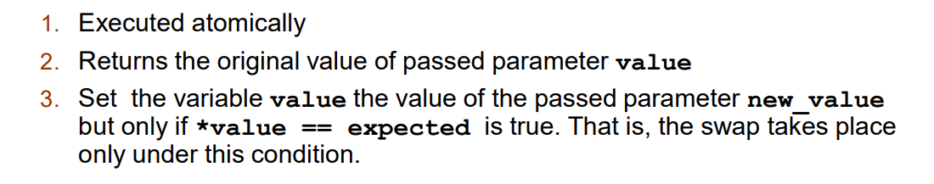
Compare And Swap(CAS)
The CAS instruction takes three parameters:
  a location, an "expected value" for that location, and a new value for the location.
It checks that the contents of the location match the expected value.
  If it matches, it replaces them with the new value,
  if it does not match, it has no effect. In any case, the previous value of the variable is returned.

Slide 19
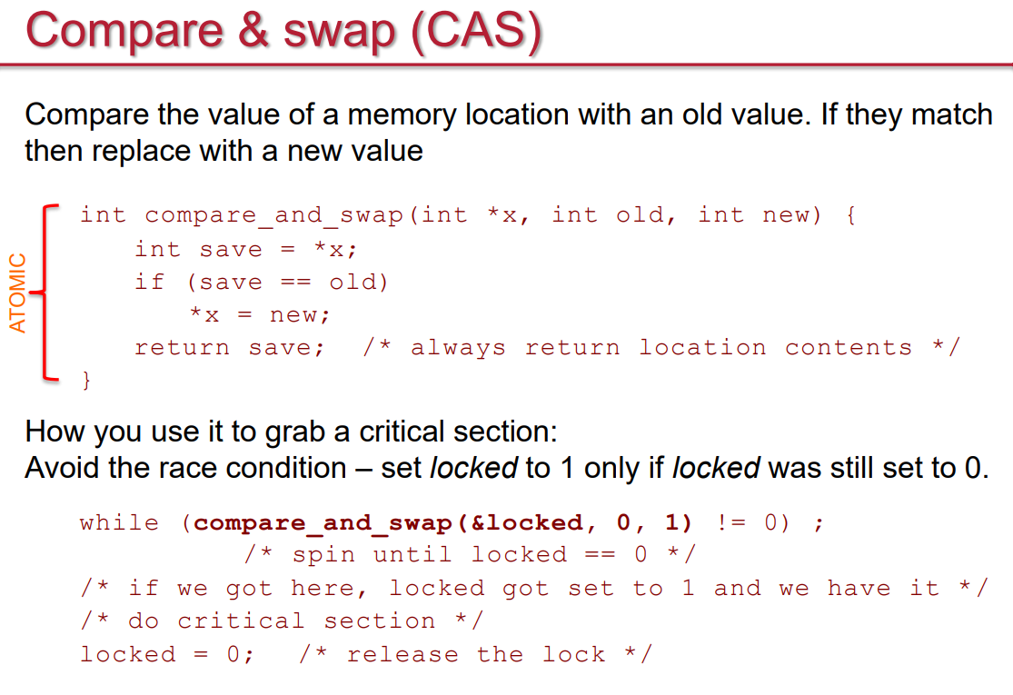
Notes:
This can be used to implement a more sophisticated spin lock that stores the thread identifier in the lock (instead of just true or false). The following code ensures that at most one thread can be in the critical section, and if there is a thread in the critical section, then the value of the lock variable is the thread's identifier (or 0 if there is no thread in the CS):

Slide 20
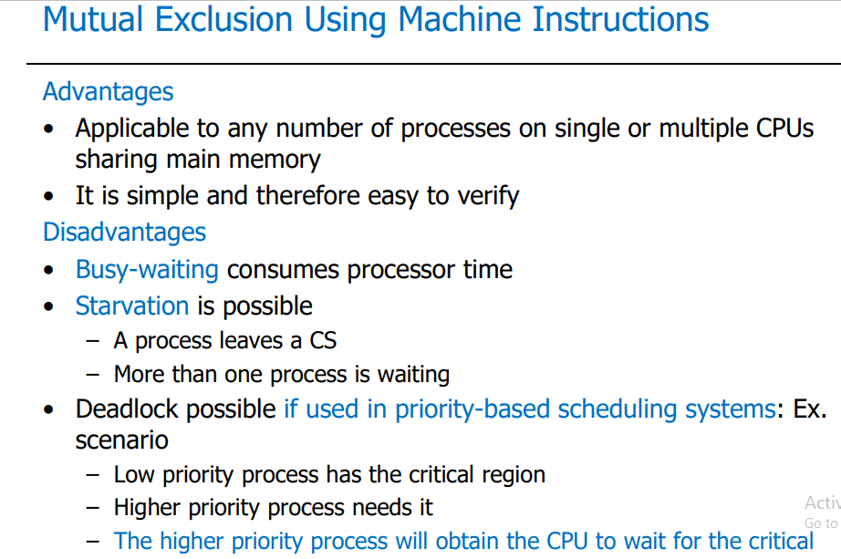

Slide 21
Busy-waiting
The problem with this (and S/W based) implementations is busy-waiting.
What if one thread already has the lock, and another thread wants to acquire the lock?
The acquiring thread will spin until the thread that already has the lock unlocks it.
Waste of CPU resources

Slide 22
Sleep and Wakeup
The solution is that if a process Pi cannot enter the critical section
Pi should not waste CPU’s time by executing the Idle loop.
Pi’s status should be changed from Run to Block
Pi should be removed from the ready list
Entered in a block list
Since, Pi is not in the ready list, no context switch will bring Pi in the run state
Thus, Pi will not waste CPU’s cycle.

Slide 23
Sleep and Wakeup
Later on, when Pi can enter the critical section, Pi’s status should be changed from block to ready
It should be entered in the ready list.
Dispatch
Ready
Running
No CPU time wastage
Can Enter the
Critical Section
Cannot Enter the
Critical Section
Blocked

Slide 24
Sleep and Wakeup: Implementation
Sleep() and Wakeup() can be two system calls.
When a process Pi determines that it can not enter the critical section it calls sleep()
  Pi Entered in the block list
When the other process finishes with the critical section, it wakesup Pi, Wakeup(Pi)
  Pi Entered in the ready list
Wakeup takes a single input parameter, which is the ID of the process to be unblocked

Slide 25
Priority Inversion
Consider a task L, with low priority, that requires a resource R.
Now, consider another task H, with high priority.
  This task also requires resource R.
  If H starts after L has acquired resource R, then H has to wait to run until L relinquishes resource R.

Slide 26
Priority Inversion
Problem arises When a new task M (which does not use R) starts with medium priority during this time.

Slide 27
Priority Inversion
Since R is still in use (by L), H cannot run.
Since M is the highest priority unblocked task, it will be scheduled before L.
Since L has been preempted by M, L cannot relinquish R.
So M will run until it is finished, then L will run - at least up to a point where it can relinquish R - and then H will run.

Slide 28
Priority Inversion
Thus, in the scenario above, a task with medium priority ran before a task with high priority, effectively giving us a priority inversion.

Slide 29
Possible Solution: Priority inheritance
If high priority task has to wait for some resource shared with an executing low priority task,
  the low priority task is temporarily assigned the priority of the highest waiting priority task
  keeping medium priority tasks from pre-empting the (originally) low priority task, and thereby affecting the waiting high priority task as well.

